Slide 1
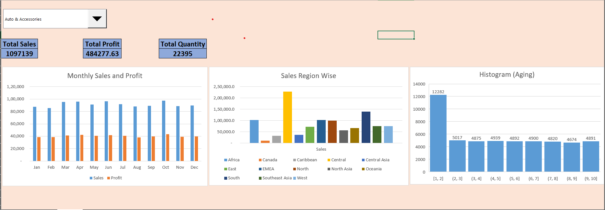
E-Commerce Sales Dashboard

Slide 2
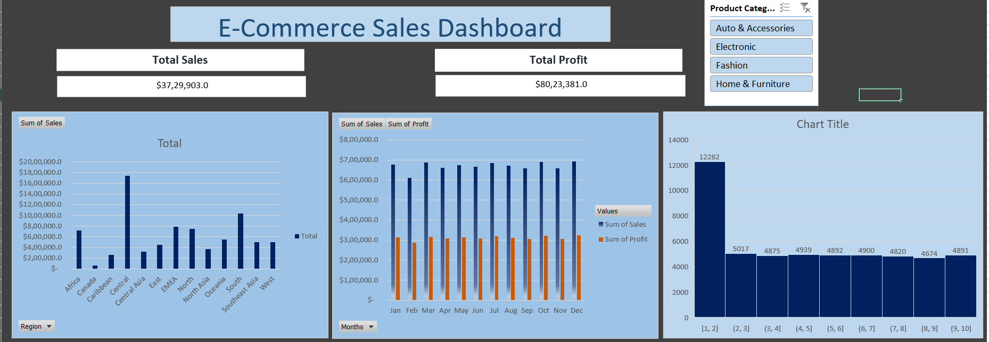
E-Commerce Sales Dashboard (Using Pivot and Slicer)

